Slide 1
HPQ Stock Analysis
By Richard Twitty

Slide 2
The Problem
Stock market in general is difficult to anticipate. The price flow, whether it buy or sell, or a dead market.
The average stock market return is 10%. We want greater returns
What are ways to increase profit returns?
Can we predict price flow of the market?

Slide 3
Who might be interested?
Companies who invested in HPQ stocks
Day trader
Positional traders

Slide 4
What condition might affect the market price?
Employee layoff
Major events
News trend
Volume

Slide 5
Data Information
Data acquired for the period: 1/2/1970 to 7/2/2020
Data: trading data for HPQ
Number of records: 12741
Number of fields: 7(initially) 68( generate columns from candlestick analysis and indicator), 10(final analysis)

Slide 6
Steps for HPQ Stocks
Generate candles patterns from charts
Generate a MACD and RSI scatter plot of HPQ market
Generate a Fibonacci chart of HPQ market
Generate a line chart for high, low, open, and close
Generate a correlation matrix for matrix
Generate models without grid search
Generate models with grid search

Slide 7
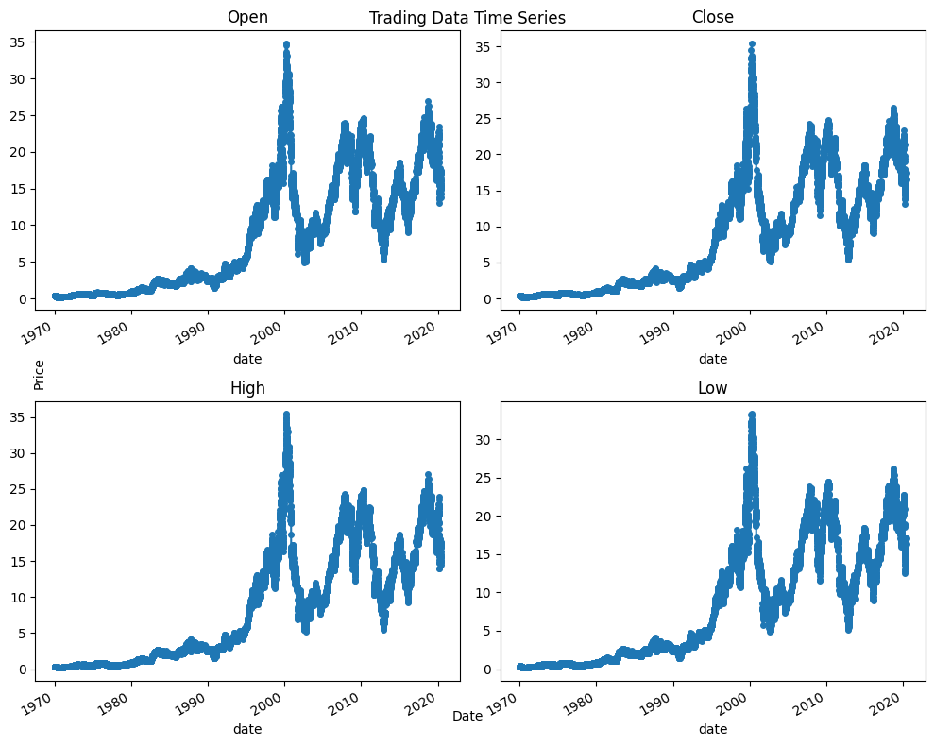
Data Exploration

Slide 8
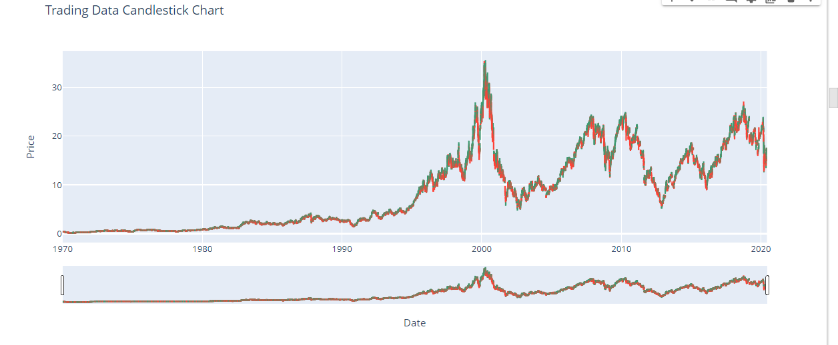
Data Exploration

Slide 9
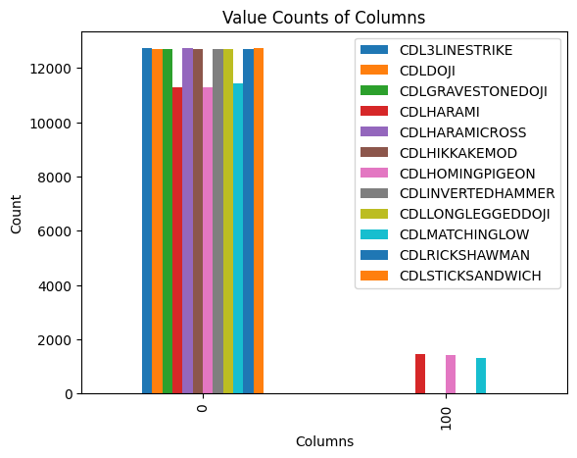
Data Exploration

Slide 10
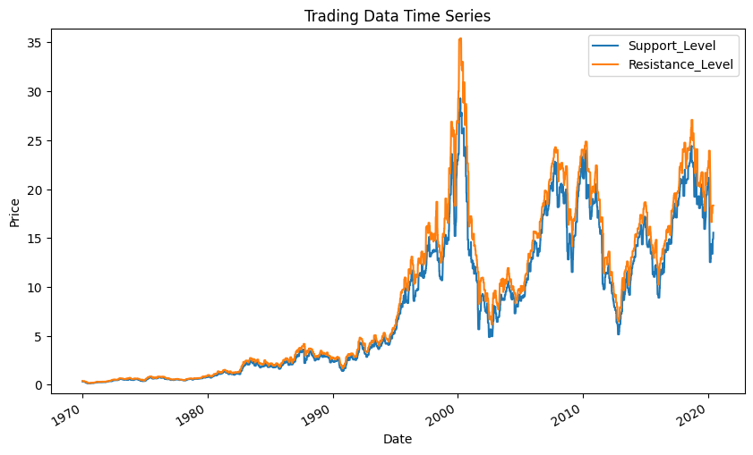
Data Exploration

Slide 11
Data Exploration

Slide 12
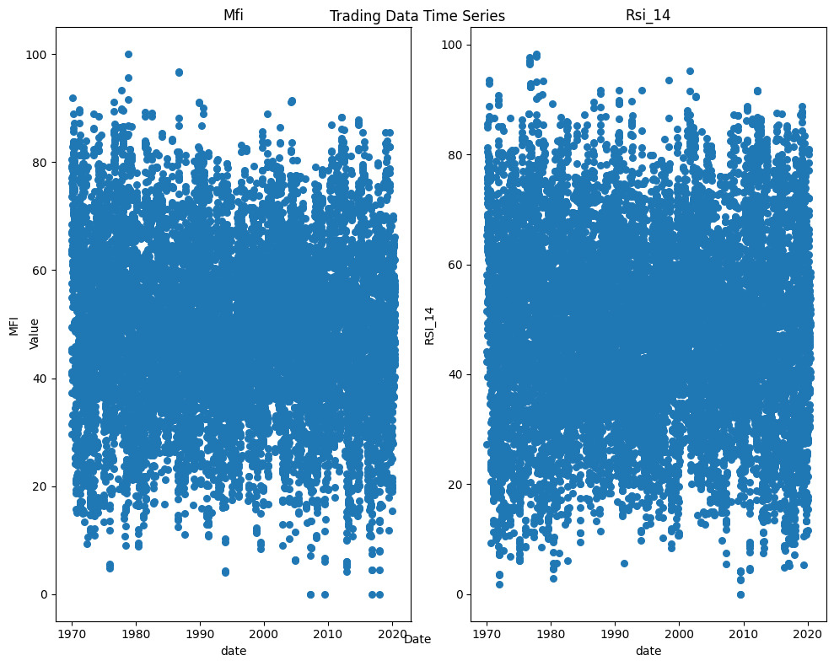
Data Exploration

Slide 13
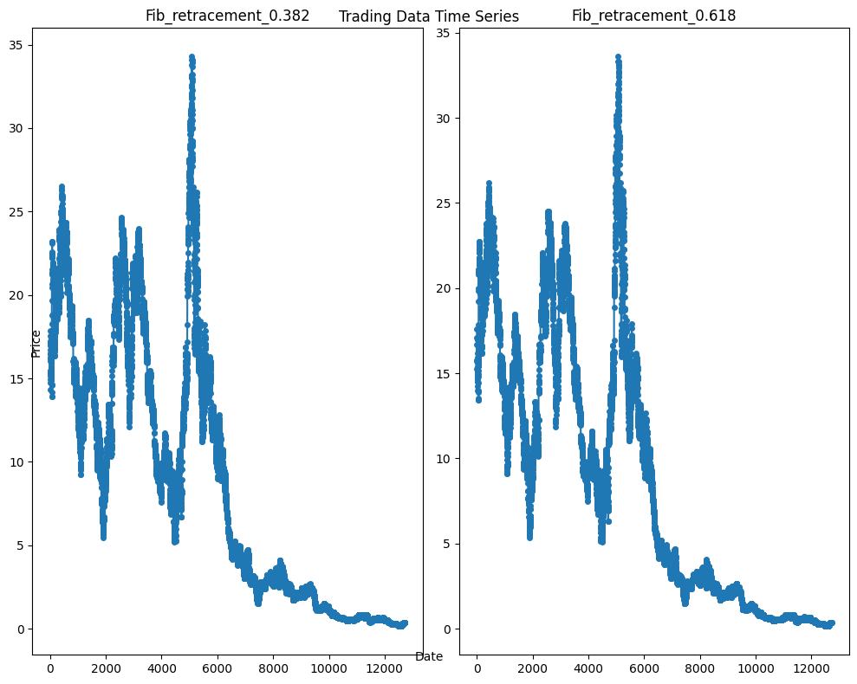
Data Exploration

Slide 14
Model Selection (Without Gridsearch)
Linear Regression: .46
Decision Tree Regression: -0.62
Support Vector Regression: -0.62

Slide 15
Model Selection (Gridsearch)
Ridge: 0.38
Polynomial Regression: .55
Support Vector Regression: .67
Decision Tree Regression: 0.06
MLP Regression: 0.06

Slide 16
Conclusion
Support Vector is the best model
I didn’t need the candlestick pattern column because it didn’t contribute much

Slide 17
Future Research
News sentiment analysis
Social media analysis
Allocate more data
Do a hourly analysis

Slide 18
Reference
https://www.kaggle.com/datasets/qks1lver/amex-nyse-nasdaq-stock-histories

